Slide 1
Real-Time Influence of Hubs and Communities
by In Woo Park, Michael Rogers

Slide 2

r/Place History
On April 1, 2017, a social experiment created by Josh Wardle was conducted on Reddit for 72 hours.
Users on the website were allowed to place one pixel on a public communal canvas with a cooldown rate between 5-20 minutes.
The results concluded with an amazing time lapse footage of the interactions between users on Reddit.
Over 1 million users participated.

Slide 3
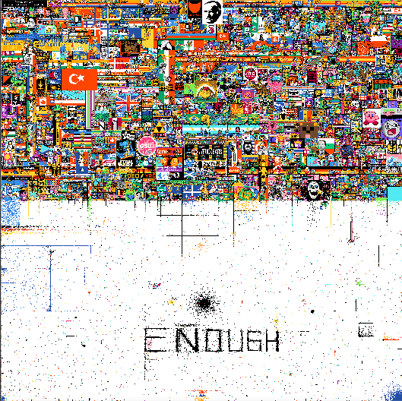
r/Place 2022
5 years later on April 1, 2022, Reddit revived the social experiment with the re-introduction of r/place and the public communal canvas.
Size: (1000 x 1000) pixels
The difference was that the canvas would double in size every day.

Slide 4
The Project
A research paper about r/place, it’s complete history in 2022, the community participation, and hub influence from popular nodes.

Slide 5
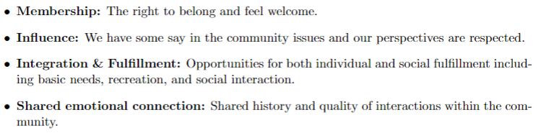
Communities
on top of Barabasi’s description of what a community is, we introduce a new attribute, longevity (resilience)
Therefore,
image on canvas = community
longevity = strong/weak

Slide 6
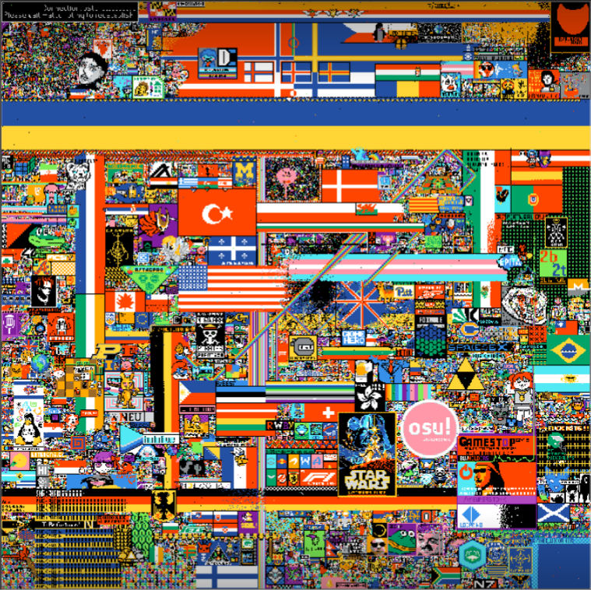
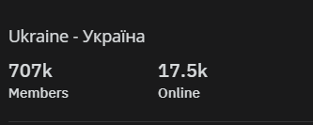
Day 1, Hour 5
r/Ukraine, r/Turkey, r/US

Slide 7
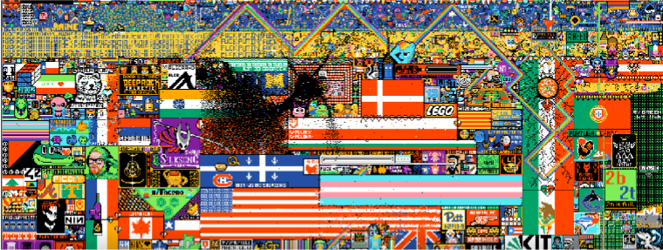
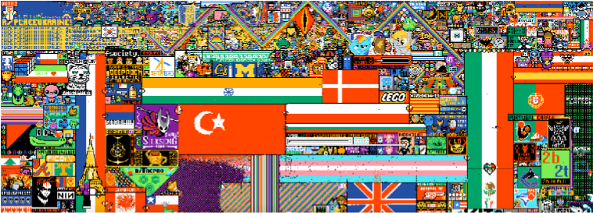

Slide 8
Interesting Findings

Slide 9
Interesting Findings
Communities went to war over land
Action States:
Defend
Attack
here is an example of hubs influencing their community to attack r/France
here is an example of a hub attack r/osuplace

Slide 10
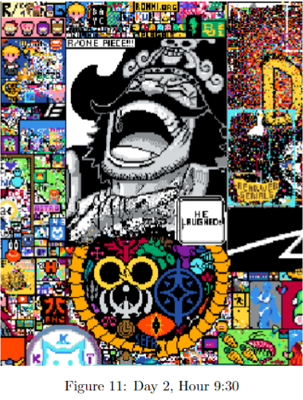
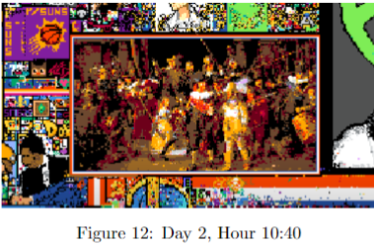
Interesting Findings
Outlier Communities
Communities that are considered strong by exception.
the artwork is just too good to be attacked.

Slide 11
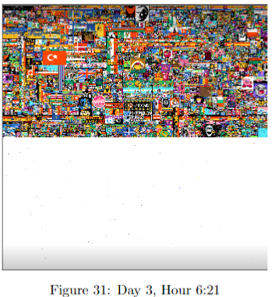
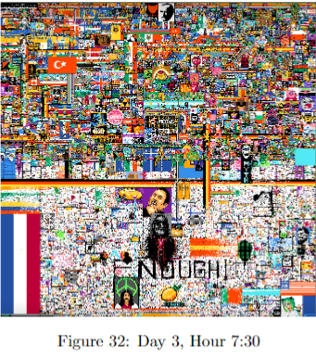
Interesting Findings
The War Against r/France
when the canvas expanded on the 3rd day, r/France look a large portion of the canvas for their flag. Other communities were not amused. Heatmap

Slide 12

Interesting Findings
Among Us
Hidden Among Us characters everywhere (estimated 2k-4k)

Slide 13
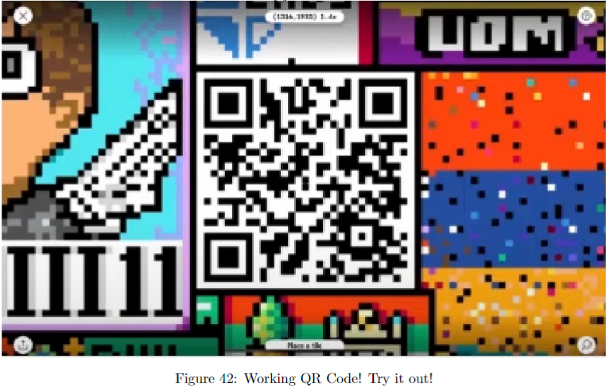
Interesting Findings
working QR Codes

Slide 14
Final Statistics
This year’s public canvas featured greater than 10.4 million total users who placed at least one tile and a total tile count of greater than 160 million.
During peak r/place activity, greater than 5.9 million tiles were placed per hour with greater than 1.7 million users setting tiles per hour.

Slide 15
Final Statistics: Top Communities (Descending)
r/placenl
r/placefrance
r/placecanada
r/osuplace
r/ainbowroad
r/placede
r/americanflaginplace
r/place
r/u cod mobile official
r/placestart
r/u microsoft surface
r/thebluecorner
r/cavestory
r/greenlattice
r/theblackvoid

